Slide 1
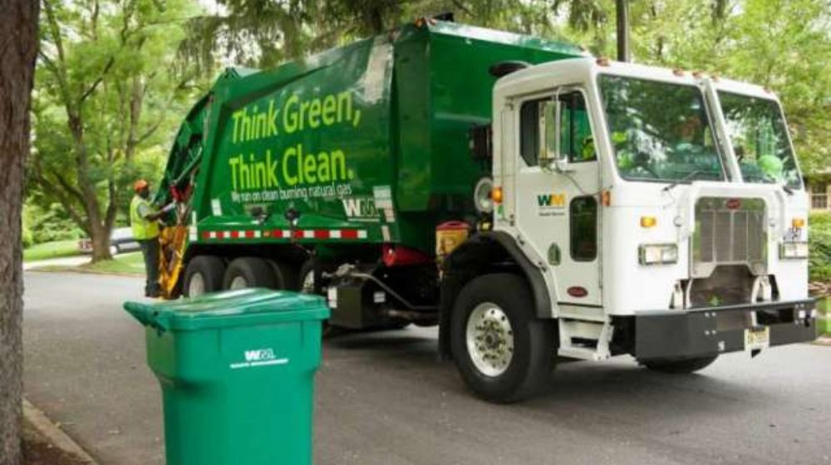
CLEAN AND GREEN PAKISTAN
PRESENTED BY
IQRA MEHMOOD

Slide 2
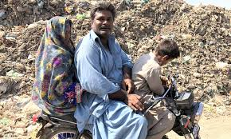
INTRODUCTION
Pollution in Karachi has become a multifaceted problem, stemming from various sources such as industrial activities, vehicular emissions, waste mismanagement, and the burning of solid waste.
Karachi, the bustling metropolis and economic hub of Pakistan, is known for its vibrant culture, diverse population, and dynamic urban landscape. However, amid the city’s rapid growth and industrialization, there is a pressing issue that threatens the well-being of its residents: pollution. The air, water, and land pollution in Karachi have reached alarming levels, posing severe health risks to the people living here.

Slide 3
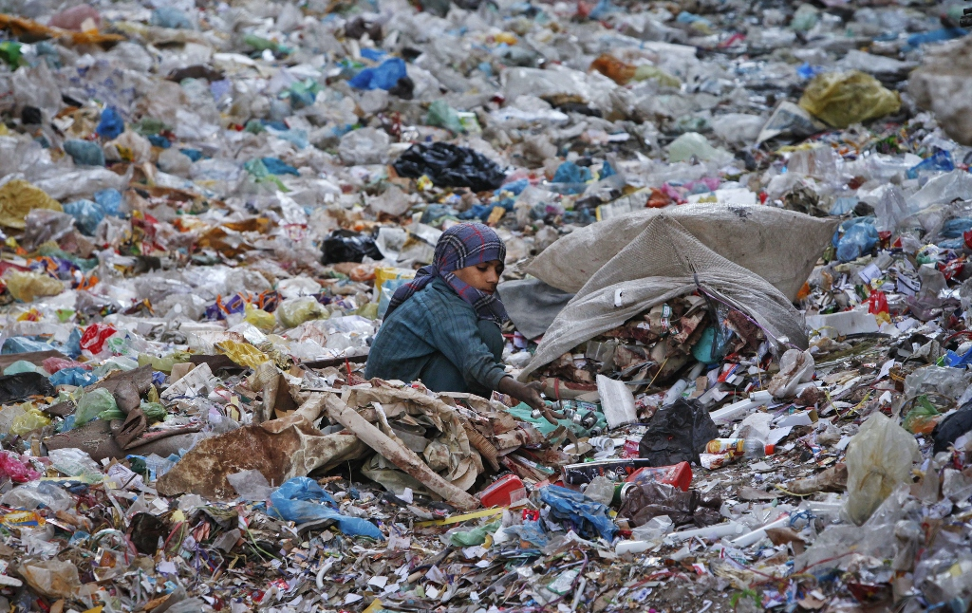
Mismanagement of solid waste exacerbates the pollution crisis in Karachi. Improper disposal of garbage, coupled with the uncontrolled burning of waste, releases toxic fumes and chemicals into the air, further contributing to air pollution. This practice not only affects the immediate vicinity but also poses long-term health risks for the city’s inhabitants.

Slide 4
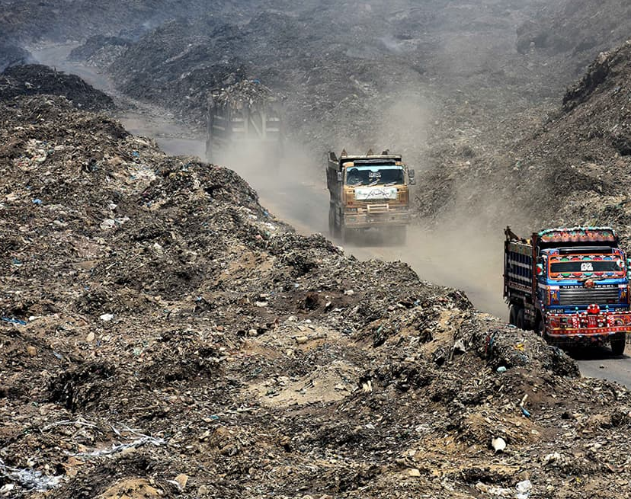
PROBLEM ON WHICH I’M WORKING:
The Jam Chakro Dumping Site and similar uncontrolled landfill sites can pose various health hazards to both the environment and nearby communities. Here are some ways in which these dumping sites can be dangerous for health:
1. Air Pollution: Dumping sites release various pollutants into the air, including methane gas, volatile organic compounds (VOCs), and particulate matter. These pollutants can contribute to respiratory problems, exacerbate existing respiratory conditions, and increase the risk of lung diseases.

Slide 5
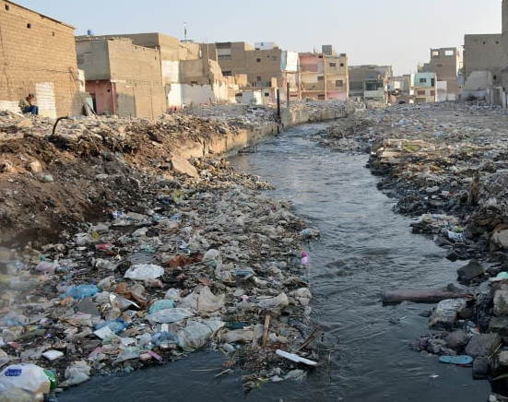
2. Water Contamination: Improper waste disposal at dumping sites can contaminate groundwater and nearby water bodies. Harmful substances from the waste, such as heavy metals, chemicals, and pathogens, can leach into the water supply, posing a risk to human health when consumed or used for irrigation.
3. Soil Contamination: Dumping sites can contaminate the soil with hazardous substances present in the waste. This contamination can affect agricultural lands and food crop.

Slide 6
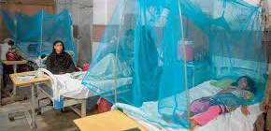
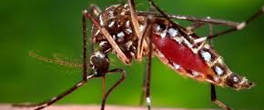
4. Vector-Borne Diseases: Dumping sites can attract pests such as rats, flies, and mosquitoes, which thrive in the presence of abundant waste. These vectors can transmit diseases like dengue fever, malaria, and other infections, increasing the risk of outbreaks in nearby communities.
5. Odor and Aesthetic Impact: Dumping sites often produce strong, unpleasant odors due to the decomposition of organic waste. The odor can cause discomfort and stress for nearby residents, affecting their quality of life and mental well-being.

Slide 7
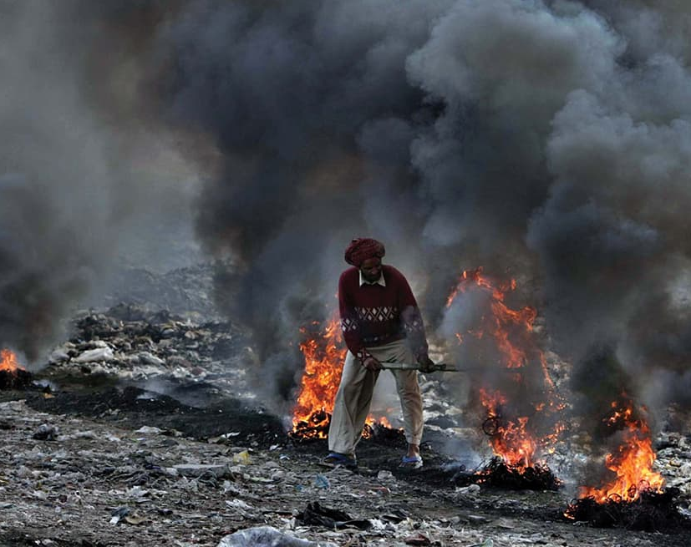
6. Accidents and Fires: Dumping sites are at risk of accidents and fires due to the presence of flammable materials, hazardous waste, and improper waste management practices. These incidents can release toxic fumes into the air and pose immediate dangers to the health and safety of nearby communities.
It is crucial to address these health hazards by implementing proper waste management practices, including waste segregation, controlled landfilling, recycling, and waste-to-energy technologies. Regular monitoring, enforcement of regulations, and community education are essential to mitigate the health risks associated with dumping sites.

Slide 8
SOLUTION OF PROBLEMS:
Research and Analysis: Conduct a waste audit to determine the types and quantities of waste generated in our community or organization. Identify the most common materials that can be recycled, such as paper, plastics, glass, and metals.
Education and Awareness: Develop an educational campaign to inform the community or employees about the importance of recycling. Raise awareness about the benefits and proper methods of recycling through workshops, presentations, and informational materials.
Collection Infrastructure: Set up a convenient and accessible system for collecting recyclable materials. Provide designated recycling bins in public areas, workplaces, and residential areas. Ensure clear signage and instructions on what can be recycled.

Slide 9
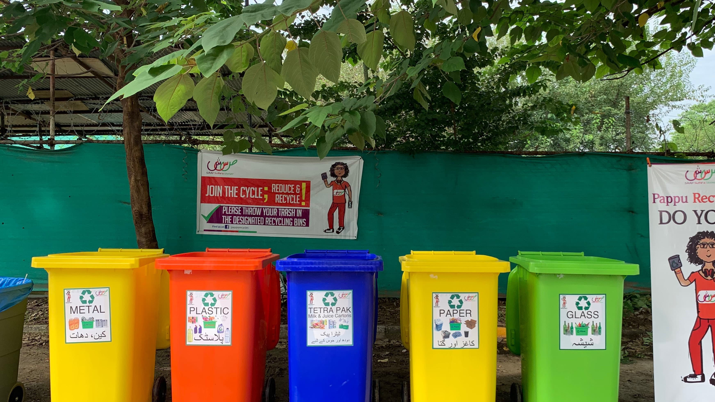
Partnerships: Collaborate with local recycling centers, waste management companies, or nonprofit organizations to establish a partnership. They can provide support, resources, and expertise in recycling operations, such as collection, sorting, and processing.
Sorting and Processing: Establish a system for sorting and processing collected recyclables. This may involve manual or automated sorting methods to separate different types of materials effectively.
Recycling Facilities: Ensure that there are nearby recycling facilities capable of handling the materials collected. If necessary, explore options for establishing or expanding local recycling facilities to accommodate the increased volume of recyclables.
Monitoring and Evaluation: Regularly monitor and evaluate the progress of the recycling program. Track the amount of waste diverted from landfills, the participation rate, and the quality of recyclable materials collected. Use this data to identify areas for improvement and adjust the program as needed.

Slide 10
Recycling Facilities: Ensure that there are nearby recycling facilities capable of handling the materials collected. If necessary, explore options for establishing or expanding local recycling facilities to accommodate the increased volume of recyclables.
Monitoring and Evaluation: Regularly monitor and evaluate the progress of the recycling program. Track the amount of waste diverted from landfills, the participation rate, and the quality of recyclable materials collected. Use this data to identify areas for improvement and adjust the program as needed.
Continuous Improvement: Continually strive to improve the recycling program by addressing challenges, expanding the types of materials accepted for recycling, and exploring innovative recycling technologies or initiatives
“Remember, a successful recycling project requires collaboration and active participation from the community or employees. Engage stakeholders, provide clear guidelines, and emphasize the positive impact recycling can have on the environment and the local community”.

Slide 11
COST/SCHEDULE
It is challenging to provide an exact figure for the cost of opening a solid waste management plant.
Waste Segregation and Recycling: We will launch a comprehensive waste segregation and recycling program, empowering residents, businesses, and institutions to actively participate in waste reduction and recycling initiatives. Extensive awareness campaigns, educational workshops, and the provision of convenient recycling facilities will drive community engagement and promote sustainable waste management practices.
Waste to Energy Technologies: Exploring innovative waste-to-energy technologies will be a key component of our proposal. By harnessing the energy potential of the waste, we can contribute to the development of a self-sustaining system, reducing landfill dependence, and generating renewable energy for our community.
Consulting with industry experts or contacting local waste management authorities can also provide valuable insights regarding specific cost factors in such area, we seek your support and partnership to turn this vision into reality. Together, we can secure the necessary funding, engage stakeholders, and mobilize resources to bring about lasting change for the betterment of our community.

Slide 12
EXECUTIVE SUMMARY
The primary objective of the Solid Waste Management Plant and Jam Chakro Dumping Site is to establish a modern, well-equipped facility to handle the growing amount of solid waste generated by the community. The project aims to achieve efficient waste management, reduce environmental pollution, and promote sustainable waste disposal practices through effective recycling and waste-to-energy conversion.
KEY FEATURES OF THE SOLID WASTE MANAGEMENT PLANT INCLUDE:
Advanced Sorting and Recycling: The plant will utilize automated sorting systems to separate different types of recyclable materials such as plastics, paper, glass, and metals. This will enable efficient recycling and minimize the amount of waste sent to the landfill.
Organic Waste Composting: The facility will have a dedicated section for composting organic waste, such as food scraps and garden waste. Through proper composting techniques, the plant will produce high-quality compost that can be used in agriculture and landscaping.

Slide 13
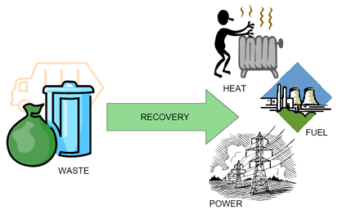
Waste to Energy Conversion:
The plant will employ waste-to-energy technologies, such as incineration or anaerobic digestion, to convert non-recyclable waste into electricity or heat energy. This process will help reduce the reliance on fossil fuels and contribute to renewable energy generation.
The Solid Waste Management Plant and Jam Chakro Dumping Site project represent a significant step towards achieving efficient and sustainable waste management in the region. By implementing advanced waste treatment technologies, promoting recycling, and ensuring proper disposal of non-recyclable waste, the project aims to minimize the environmental impact of solid waste while maximizing resource recovery. It is anticipated that this initiative will lead to cleaner surroundings, reduced pollution, and a more sustainable future for the community.

Slide 14
^{THANK YOU.}

